Slide 1
Tech-Champion 2015 Logistic Simulation by go

Slide 2
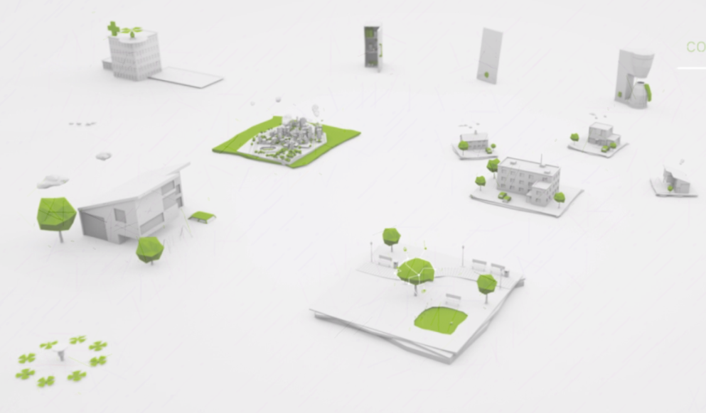
Topic Description
Target: To design a simulation system of logistic network
Run logistic on a predefined map consisted by highway connected cities
Deliver large number of packages with different source/destination/weight
Use fixed number of trucks with same load limitation and fixed max speed
Storage can be setup at any cities
Evaluation Criteria
The winner shall deliver all the packages
In required time
Technical Requirement
Use Go Language
Distributed system
Each entity is an independent executable.
Entities communicate via network

Slide 3
Why GO
Popular. Google, Cloud Foundry, Apcera, docker, Core OS…
“Go will become the dominant language for systems work in IaaS, Orchestration, and PaaS.”, -- by Derek Collison
Why Go?
Simple compiled language, fast in building.
Good Standard Library, already very powerful without 3rd party packages.
Concurrency, channel, go routine…
Garbage collection, pros and cons
Well organized package importing, fully qualified path
Defer
Simple public/private
Not OO but still can write “class”, func() bind to data.

Slide 4
Go code peeks – simple
package main
import (
"errors"
log "repo.oam.ericloud/poc2015/util/levlog"
)
func main() {
log.Start(log.LevelTrace)
log.Trace("Hello Trace")
log.Info("Hello Info")
log.Warning("Hello Warn")
log.Error("Hello Error"
log.Mark()
Example()
log.Completed()
}
func Example() {
log.Started()
err := foo()
if err != nil {
log.Exitf("ERR read counter name: %s.", err)
return
}
log.Completed()
}
func foo() error {
return errors.New("Error happened.")
}

Slide 5
Go code peeks – clear import
import (
"bytes"
"encoding/json"
"flag"
"fmt"
"github.com/apcera/nats"
"github.com/go-zoo/bone"
"net/http"
"repo.oam.ericloud/paas.git/poc2015/protocol"
"repo.oam.ericloud/paas.git/poc2015/util"
log "repo.oam.ericloud/paas.git/poc2015/util/levlog"
"runtime"
)

Slide 6
Go code peeks – implicit var declare
func (r *RedisStore) RemoveSessionData(key string, f string) {
c := r.pool.Get()
defer c.Close()
redObject := app_id + "." + SessionStruct + "." + key
OK, _ := redis.Int(c.Do("EXISTS", redObject))
……
}
INSTEAD OF:
SomeClassName mySomeClassName := new SomeClassName(bla, bla, bla)
int i = 0
……

Slide 7
Go code peeks – multiple return values
func (r *RedisStore) RemoveSessionData(key string, f string) {
c := r.pool.Get()
defer c.Close()
redObject := app_id + "." + SessionStruct + "." + key
OK, _ := redis.Int(c.Do("EXISTS", redObject))
……
}
A pattern:
if Me, err := api.NewMicroService(config); err != nil
{
log.Fatal(err.Error())
}

Slide 8
Go code peeks – public/private
var me *api.MICROSERVICE
var State int
var instance_id string
var invite_counter = 0
func (p *MSCORE) FetchParameters() {
msg := p.PrepareMsg(&CMGETALL, []byte("{}"), "", "")
p.Send(msg)
//Response will be delivered to the Inbox
}
func (p *MSCORE) httpPMSender(report string) error {
resp, err := http.Post(p.PM.GetPMService(), "", )
if err != nil {
return err
}
...
}
INSTEAD OF
public static Config config;
public static ApplicationCache cache;
private Connection connOut;
private Connection connInc;

Slide 9
Go code peeks – channel, go routine
c := make(chan string)
go handler.Dispatch(s.Key, interComm)
switch sub.Sequence {
case conf.Seq2InHttpResponse, conf.Seq3PostThen200OK:
// wait for the "OK" signal to release the thread
OK := <-c
if OK == SignalNok {
http.Error(s.RespWriter, err.Error(), "Error")
}
default:
}
……
ResponseProcessor(s)
log.Printf("HTTP connection open, notify original thread.\n")
s.Channel <- SignalOk

Slide 10
Go code peeks – OO
type Session struct {
Key string // Generated uuid to identify session
MsgId string
......
}
func NewSession(mid string) *Session {
key := strconv.FormatInt(time.Now().UnixNano()+ramble, 16)
return &Session{
Key: key,
MsgId: mid,
}
}
func (s *Session) SetSequence(seq int) {
s.Sequence = seq
}
…
func someFunc(sess *Session, seq int) {
sess.SetSequence(seq)
}

Slide 11
Go code peeks – Defer
func (r *RedisStore) RemoveSessionData(key string, f string) {
c := r.pool.Get()
defer c.Close()
redObject := app_id + "." + SessionStruct + "." + key
OK, _ := redis.Int(c.Do("EXISTS", redObject))
if OK == 0 {
return
}
c.Do("HDEL", redObject, f)
}
INSTEAD OF
func (r *RedisStore) RemoveSessionData(key string, f string) {
c := r.pool.Get()
redObject := app_id + "." + SessionStruct + "." + key
OK, _ := redis.Int(c.Do("EXISTS", redObject))
if OK == 0 {
c.Close()
return
}
c.Do("HDEL", redObject, f)
c.Close()
}

Slide 12
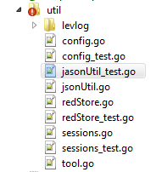
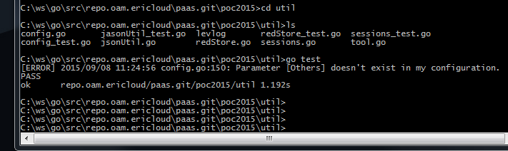
Go code peeks – unit test
import (
"github.com/stretchr/testify/assert"
"testing"
)
func TestSession(t *testing.T) {
s := NewSession("1234")
assert.Equal(t, "1234", s.MsgId)
}
func TestSessionStore(t *testing.T) {
cache := NewSessionCache()
Store = NewRedisStore("192.168.209.128:6379")
s1 := NewSession("1234")
s1.PutToStore()
s2 := NewSession("1235")
s2.PutToStore()
cache.AddSession(s1)
cache.AddSession(s2)
s4 := NewSession("1236")
s4.PutToStore()
cache.AddSession(s4)
r1 := cache.GetSession(s.Key)
assert.Equal(t, "1237", r1.MsgId)
cache.DelSession(r1)
r2 := cache.GetSession(r1.Key)
assert.Nil(t, r2)
}

Slide 13
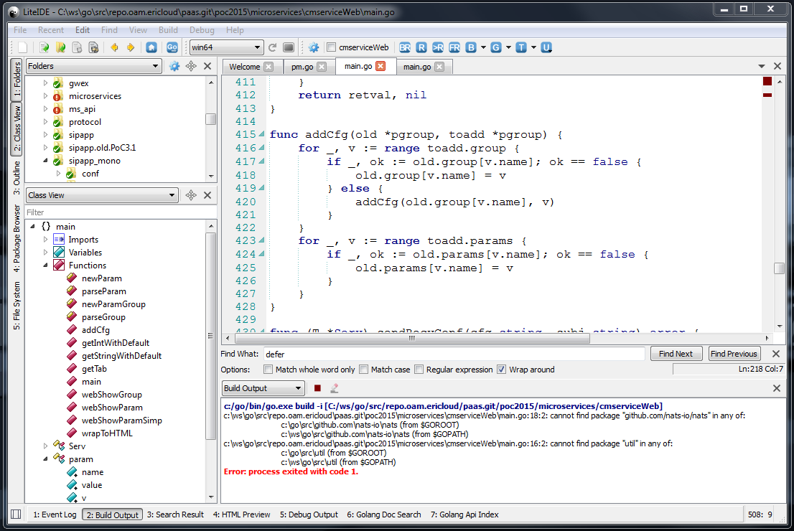
Go code peeks – ide

Slide 14
GO
Self-learning site.
Document.
Download page with installation guidelines.
Recommended IDE: liteide.
Learn Go in one video.
NATS.

Slide 15
Details - entities
Parcel: with weight, time to send, source and destination. When arriving destination, calculate distance of the route, time elapsed. An existing program will be provided to generate parcel data and feed to terminal.
Customer: generate parcels in a predefined pattern. Collect parcels and generate statistics.
Warehouse: accept/deliver parcels from/to customer. Upload/download parcels from/to trucks. Plan route for the truck, when to start and what’s the next destination.
Truck: Travel according to the route plan, spending time according to the distance and travel speed (has limit). Load/unload parcels when arriving at warehouse, spending time if doing load/unload operation. Has payload limit.
All entities communicate via message bus, NATS.

Slide 16
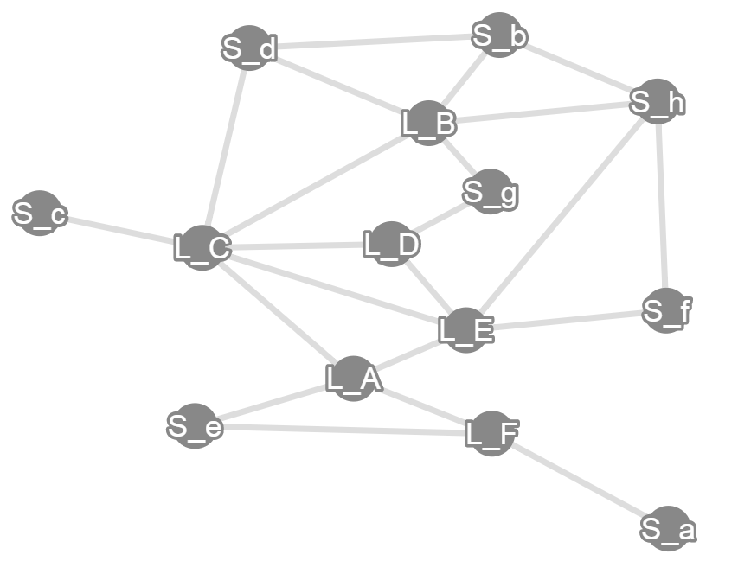
Details - map
Note: don’t assume city name in such pattern. You may get real city names like “Beijing” or “Shanghai”.

Slide 17
Detail – how it runs
Initialize
Parameters: number of trucks, truck speed, cities and each has one warehouse and terminal.
Each Customer will get the parameters for parcel generation.
Each truck will have an initial location, at a warehouse. Waiting for uploading and route plan.
Each warehouse will get a “map” file then build a overview of the traffic network.
Run
Customer generates parcels and expose interface for terminal to fetch.
Warehouse will start to fetch parcels from customer. Upon receiving parcels, starts to “thinking” which truck and when to upload it. Plan the route for the truck. When truck arrival “thinking” whether download the parcel or not. Communicate with other warehouses to get a full picture of the payloads. Deliver parcels to customer.
Truck start to go according to the plan set by Warehouse. No fuel limit. Truck doesn’t know the overall map. It just goes to the next city and waiting for the new operation.

Slide 18
Detail – when to finish
Stop
In the simulation, time is compressed, e.g., one day will be just 20s.
All the entities stop running at a moment, e.g., “30 days” (~600 real seconds) after. And do the final report to OAM.
Report
Customer and Truck will calculate the result and output.

Slide 19
Wining criteria
Most volume of parcels have been delivered. Volume of parcel = parcel weight * distance (length of the shortest path between source and destination)
Least average delivery time. Total delivery time / total volume
Highest efficiency of route planning. Volume of parcels / total actual cost. (Cost = weight * actual traveled distance)
Highest truck usage efficiency. Total distance * capacity / truck number /actual payload /speed /total time.
It’s free for each team to use 3rd party libs. But please do not install app like MySQL or complex application server.

Slide 20
delivery
We will provide a server with go environment installed.
Each team will have own account and directory.
A shell script will take the directory name as input, find the executables at proper folder and run them with input variables.
Each team have 5 minutes to start the applications and running for 10 minutes. During the program running, team shall present how they do the job.
Detail spec will be provided as a document (on paper) at the day.
We may provide message bus (NATS) as communication infrastructure and be used in DB.

Slide 21
API description & demo
NATS basics
Customer API
Truck API
Demo

Slide 22
NATS basic
NATS is a sub/pub message bus server.
A & B connect to the NATS server (gnatsd).
A subscribes “Hello”, it provides “func recvMsg()” as the entry of message.
B publishes (“Hello”, “World”) then A receives “World”.
“Hello” is the subject, recvMsg is the handler while “World” is the data.
NATS server transfer the “World” to A based on the subscription: A is interested in the subject “Hello”.
NATS supports wildcard on the subjects so that we can design our routing logic by define a structured subject.
“CITY.Shanghai.Arrive”, Shanghai subscribes to “CITY.Shanghai.*” then it can receive the msg.
“TRUCK.ALL.Stop”, all trucks subscribes to “TRUCK.ALL.*”, then all trucks will get that.
“TRUCK.1234.Upload”, truck with ID “1234” subscribes to “TRUCK.1234.*” then only this one will get the msg.
“CUST.Beijing.Get”, Customer at Beijing subscribes to “CUST.Beijing.*”. City Shanghai sends that msg will get parcels from Customer at Beijing.
NATS message:
Subject, the topic that someone subscribe to.
Reply, message receiver will use that as subject to publish the reply message. Can be empty if no return message needed.
Data, []byte, byte array, can directly convert to/from string. Any format up to application design.
Sub, subscription. Used to unsubscribe a message or polling message from NATS.
For the API, we must specify subject, reply and data format.

Slide 23
Customer API: Get & Put
Get: city gets parcels (to be delivered) from customer.
“ParcelGenerator.<city>.GetParcelList”, “<city>”, “”
Reply Data:
--1 “<number of parcels>”, if -1, time is up, no longer generate parcel.
--2 “<parcel Id> <Destination> <Weight>”
--3 …
Put: city put parcels (at destination) to customer.
“ParcelCollector.<city>.PutParces”, “<city>”
Data:
--1 “<number of parcels>”
--2 “<parcel Id> <Destination> <Weight>”
--3 …
Reply data:
--1 “Accept|Reject”
--2 “<Reject reason>”

Slide 24
Parcel Generator - setting
name | Default value | Usage
city | L_A | Setting log level
seed | 12345 | Seed for pseudo random number
avgWeight | 15 | Average parcel weight
sigma | 5 | standard deviation of weight
rate | 20 | Parcels/minute
bufferMax | 100 | Maximum parcels can be stored in generator
workTime | 10000 | Working time in (minutes)
timeFactor | 1000 | Time factor
natsUrl | nats://localhost:4222 | Setting NATS servers.
mapFile | map.data | Map file name

Slide 25
truck API, load
Load: city load one or several parcels onto truck.
“Truck.<tid>.Load”, “<city>”
Data:
--1 “<number of parcels to be loaded”
--2 “<parcel Id> <Destination> <Weight>”
Reply data:
--1 “Accept|Reject|Stopped”
If reject
--2 “FormatError|Busy|RepeatedLoad|AlreadyLoaded|Overload”
If “ALreadyLoaded”
--3 “<number of already loaded parcels>”
--4 “<parcel Id>”
…

Slide 26
truck API, Unload
Unload: city unload one/several parcels from the truck.
“Truck.<tid>.Unload”, “<city>”
Data:
--1 “-1|>0”, -1 means unload all, or number of parcels to be unloaded.
--2 “<parcel Id>”, if not -1 of first line.
…
Reply data:
--1 “Accept|Reject|Stopped”
If Accept:
--2 “<number of parcels>”
--3 “<parcel Id> <Destination> <Weight>”
Otherwise:
--2 “FormatError|Busy|RepeatedUnload|CanNotFindParcel”
If “CanNotFindParcel”
--3 “<Number of not found parcels>”
--4 “<parcel Id>”
--5 …

Slide 27
truck API, list
List: city gets the status of truck and list of parcels carried
“Truck.<tid>.List”, “<city>”, “”
Reply data:
--1 “Idle|Busy|Stopped”
--2 “<Name of the current city>”
--3 “<Remaining busy time in nanoseconds>”
--4 “<Remaining working time in nanoseconds>”
--5 “<Real-time load duration in nanoseconds>”
--6 “<total capacity of the truck>”
--7 “<remaining capacity of the truck>”
--8 “<number of the parcels on the truck>”
--9 “<Parcel Id> <Destination> <Weight>”
--10 …

Slide 28
truck API, goto & arrive
Goto: city orders truck go to next city.
“Truck.<tid>.Goto”, “<city>”, “<next_city>”
Reply data:
--1 “Accept|Reject|Stopped”;
--2 “FormatError|Busy|NoDirectConnection”
Arrive: notify the arriving city. Happen once when at startup and after “Goto”.
“Arrive.<city>”, “”, “<tid>”

Slide 29
Truck - Settings
Environment Variables and start command settings:
ENV name | CMD flag | Default value | Usage
LOG_LEVEL | log | 4 | Setting log level
NATS_URI | nats | nats://localhost:4222 | Setting NATS servers. Use ; to split urls.
MAP_NAME | map | map.data | Map file name
CAPACITY | c | 2000 | Capacity
SPEED | s | 1 | Speed in (m/s)
LOAD_DURATION | ld | 60 | Load duration in (minutes)
WORKING_TIME | w | 10000 | Working time in (minutes)
TIME_FACTOR | f | 1000 | Time factor
TRUCK_ID | id | t0 | Truck ID
INIT_CITY | init | L_A | Initial city

Slide 30
Map file format
14
L_A 4
L_F 68411
L_E 107434
S_e 71983
L_C 104637
L_B 5
S_h 152176
S_b 60120
S_g 92080
L_C 100141
S_d 142410
L_C 6
L_D 66836
S_d 116140
L_B 100141
L_E 111481
L_A 104637
S_c 75509
L_D 3
L_E 147606
S_g 72455
L_C 66836
L_E 5
S_f 152249
L_D 147606
L_C 111481
L_A 107434
S_h 93816
L_F 3
S_a 109448
S_e 131505
L_A 68411
S_a 1
L_F 109448
S_b 3
S_h 85368
L_B 60120
S_d 65739
S_c 1
L_C 75509
S_d 3
L_C 116140
L_B 142410
S_b 65739
S_e 2
L_A 71983
L_F 131505
S_f 2
L_E 152249
S_h 97899
S_g 2
L_D 72455
L_B 92080
S_h 4
S_f 97899
S_b 85368
L_B 152176
L_E 93816

Slide 31
Map

Slide 32
environment
Server: 146.11.25.2, port: 17220, protocol: SSH/SCP/SFTP
Account: <team_name>/<team_name>123. E.g.: talos/talos123
Proxy setting in case you need to fetch package from github.com:
“export http_proxy=http://localhost:50081”
“export https_proxy=http://localhost:50081”
Golang (1.4.2) has been installed and configured already. Please try.
Dependent source code at /home/rdcloyi/go/src/simu. Please use that for your development and testing, e.g., generate you own map file and generate parcels.
Team names:
astro, dream, flyfish, grape, navi, qwerty, talos
NATS server at nats://localhost:4222 already started. If you want to development directly on the server then you should try prevent conflict with others. So you had better start your own nats server.
gnatsd –p 40001 –l ‘nats.log’
40001 is the port for your team and nats.log is the log file.

Slide 33
Competition
Each team shall build an executable file named city at /home/<team> folder. For example, team name is “benz”, then test script will goes to /home/benz to find city to run.
The city must take below four parameters:
--city city_name
--nats nats_uri
--time time_factor
--map map_file_directory_and_name
Example: city –city shanghai --nats nats://localhost:4222 –time 1000 --map /home/rdcloyi/map.data

